Slide 1

Min He, 01/27/2021
NaaS, Turns Network Into a Service Platform ADN, Brings Autonomy to Network O&M

Slide 2

Challenges of Telecom/ICT Industry
Complexity
Silo, Fragmented
Agility
Costs reduction
Time to market
Excellent User Experience
OpEx ratio: 50%->67%,
1.9%
75B devices by 2025
TCO ＞Revenue
OpEx Vs CapEx: 3:1
Last 5 years
Infrastructure & Operations
Cost & Growth
Simplification
Automation
Intelligence
Collaboration
Efficiency
Manual, error-prone
Isolation
Lack of global business collaboration
3
vs
300+
OTT Vs Telco to maintain
The whole industry is facing the challenges of revenue growth, business collaboration, operations efficiency and TCO, which led to the reduction of profit margin, sales and innovation
Solving the Structural Problems with Architecture Innovation

Slide 3
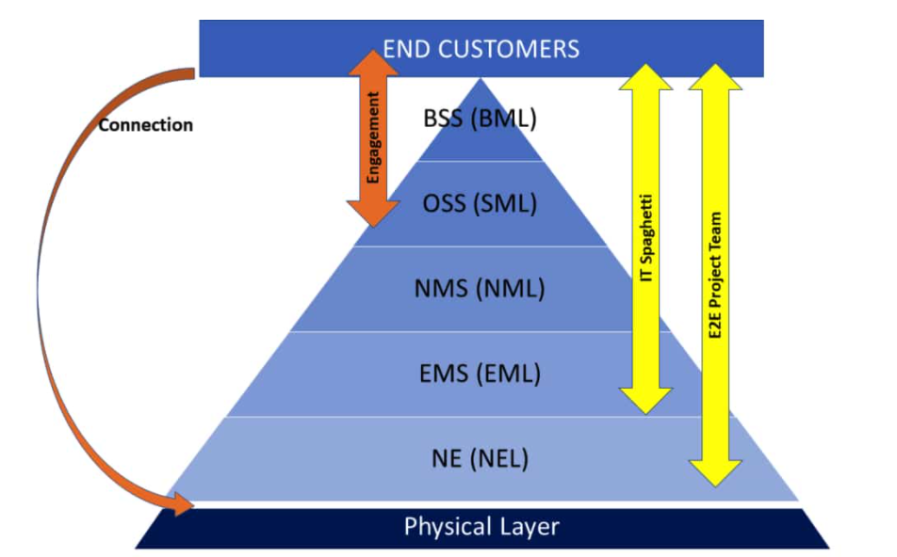
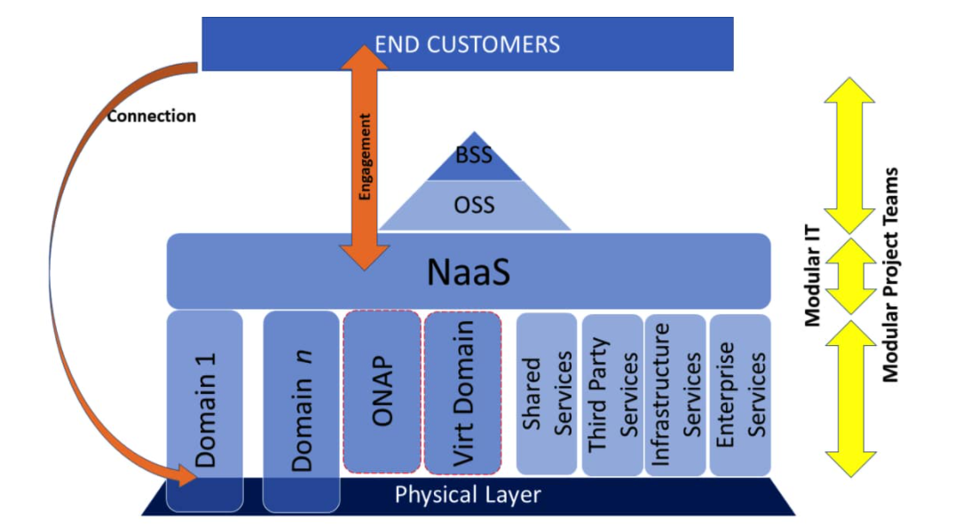
Simplify IT and CT Interaction with NaaS Architecture
Decouple BSS/OSS and Network Layers and Utilize X-as-a-Service Model
Tightly IT/CT coupled silos
Mesh integration points
Expense and Slow
Separation of concerns
Decouple the OSS and network layers.
Greatly reduce number of integration points
Enabling E2E automation
Deliver fast time to market product offering
Open new revenue stream potential

Slide 4
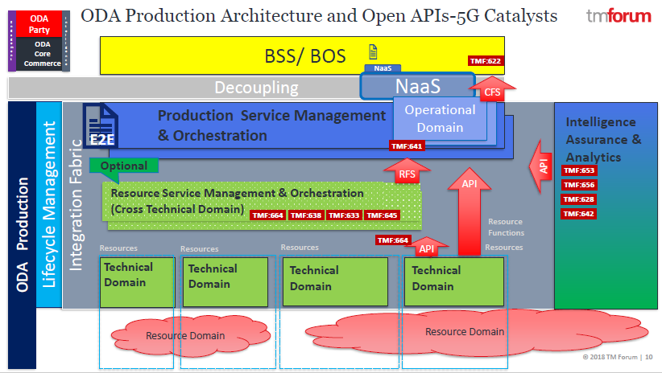
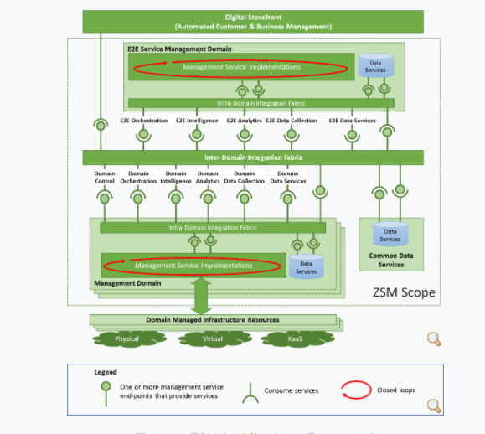
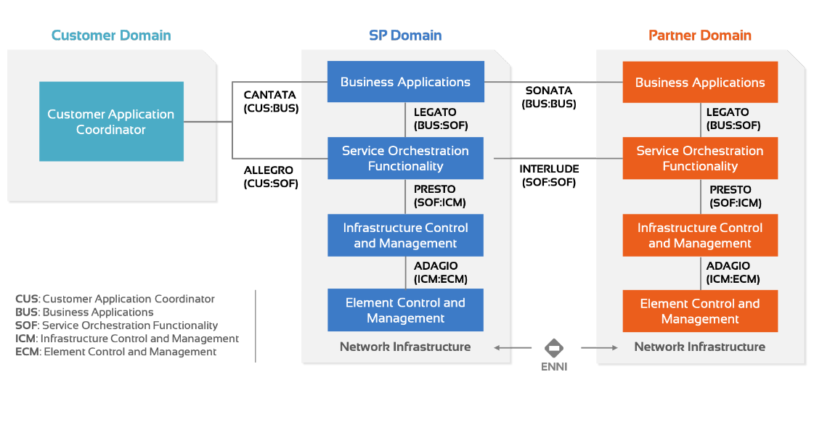
Same Principles and Different Focuses
TMF ODA Architecture
ETSI ZSM（Zero Touch Management) Architecture
MEF LSO（Life-cycle Service Orchestration) Architecture
NaaS
NaaS
NaaS
Simplify BOS and Network Integration
Simplify Multi-vendor Service Orchestration
Simplify Inter-CSP E2E Service Orchestration
NaaS covers connectivity services and end-point services

Slide 5
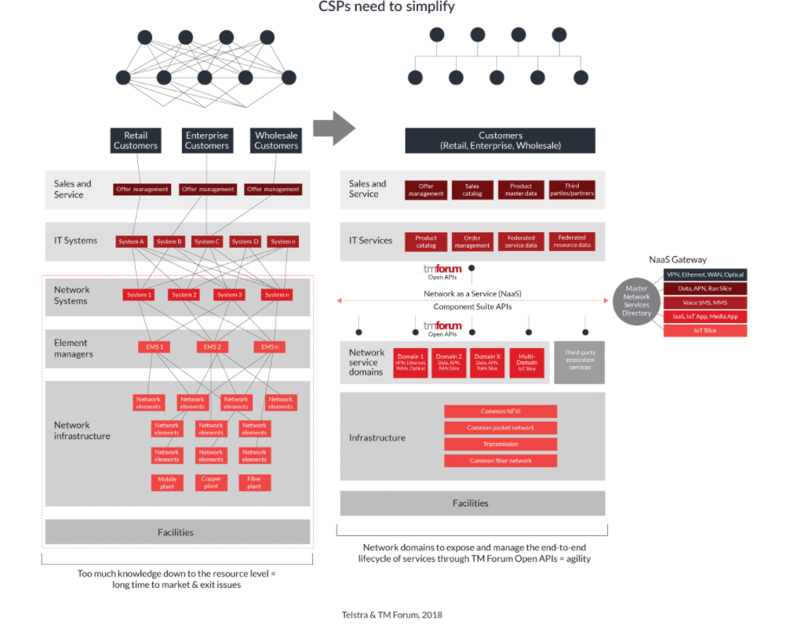
NaaS Simplifies Network and Transforms Operations Simultaneously
All of the network’s capabilities and resources—virtual and physical—are summarized and published in a service catalog.
Industry-standard APIs are used to expose these summarized capabilities to the B/OSS layer.
The entire service lifecycle is managed in a closed loop, using customer intent, policy, analytics, and AI to provide ongoing service assurance and optimization.
NaaS simplifies both IT and Network Architecture

Slide 6
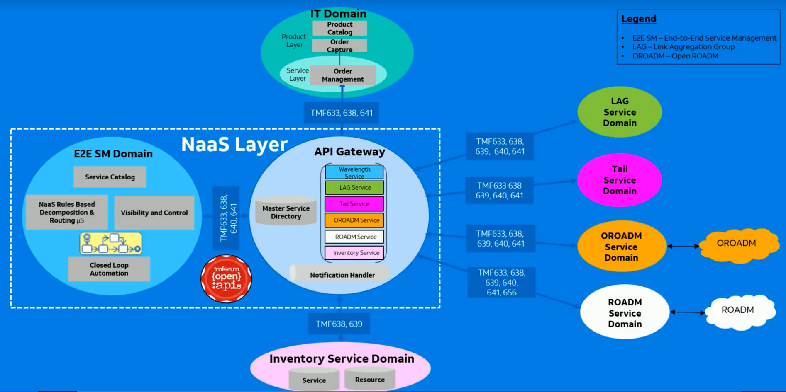
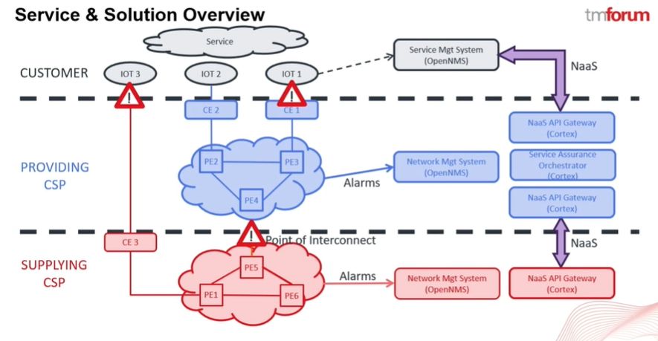
TMF NaaS Related Catalyst Projects
Automating NaaS Lambda (λ) services
Champion: AT&T
Use Case: Common service model to provision various lambda services.
Utilized TMF API:
TMF633 “Service Catalog ”,
TMF640 “Service Activation and Configuration ”,
TMF641 “Service Order Management ” ,
TMF638 “Service Inventory”,
TMF639 “Resource Inventory”,
TMF634 “Resource Catalog”,
TMF685 “Resource Pool”,
TMF625 “Trouble Ticket”.
TMF656 “Service Problem Management”
Automating service problem management business operations using the TM Forum Network-as-a-Service APIs
Champion: BT, Vodafone
Use Cases: service assurance of IoT type of service that runs on an IP VPN, where the primary or providing CSP extends its reach beyond its geographic footprint by using a second operator’s infrastructure to connect end devices.
Utilized TMF API:
TMF 656: “Service Problem API”

Slide 7
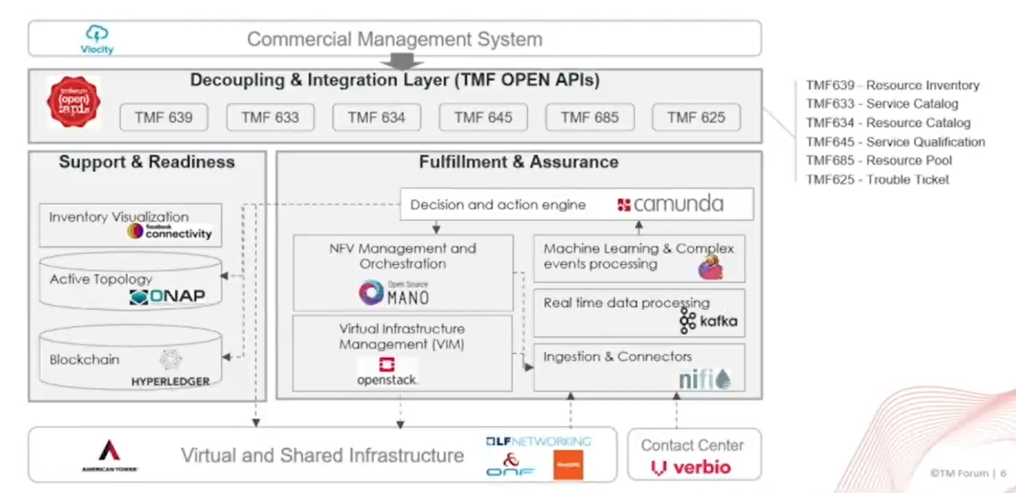
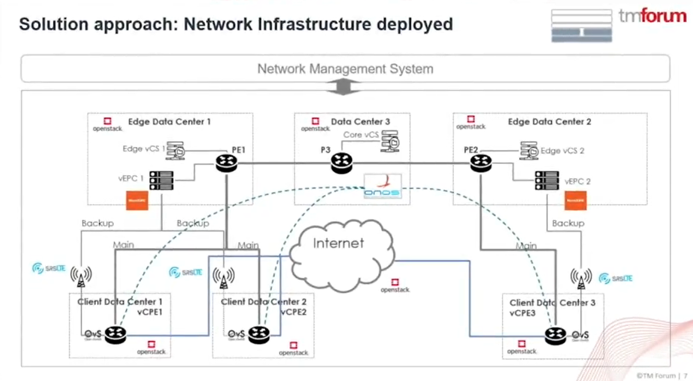
TMF NaaS Related Catalyst Projects
Boosting AIOps for full hybrid NaaS
Champion: Telefonica, American Tower
Use Case: The delivery of NaaS services for B2B clients through the application of artificial intelligence (AI) to the network operation (AIOps), enabling, for example, the automatic prevention of failures and outages.
Utilized TMF API:
TMF639 “Resource Inventory”,
TMF633 “Service Catalog”,
TMF645 “Service Qualification”,
TMF634 “Resource Catalog”,
TMF685 “Resource Pool”,
TMF625 “Trouble Ticket”.

Slide 8
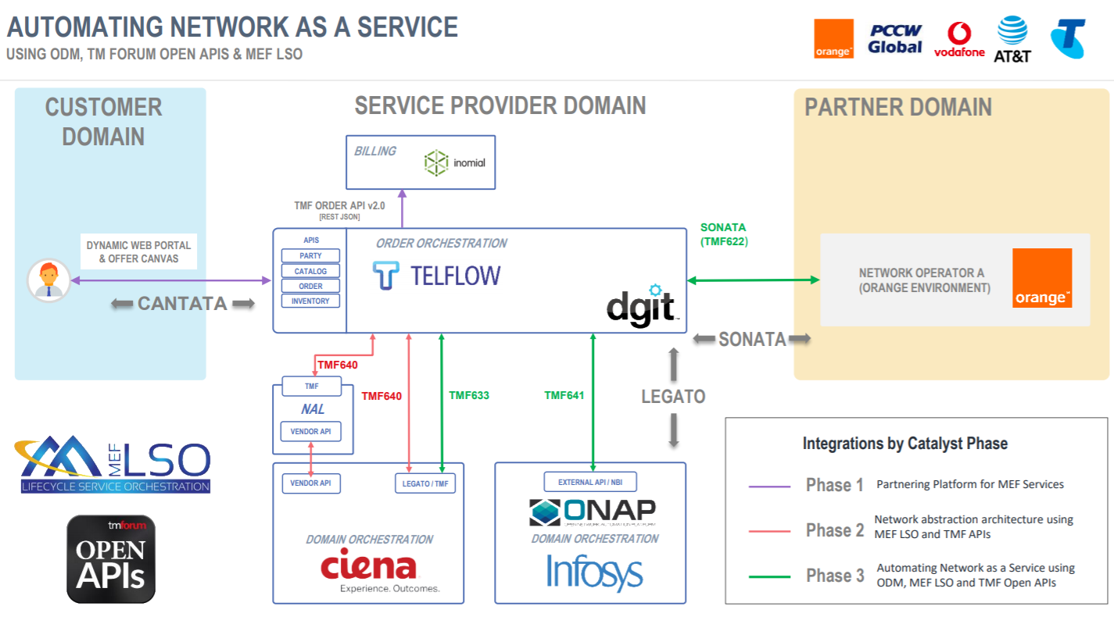
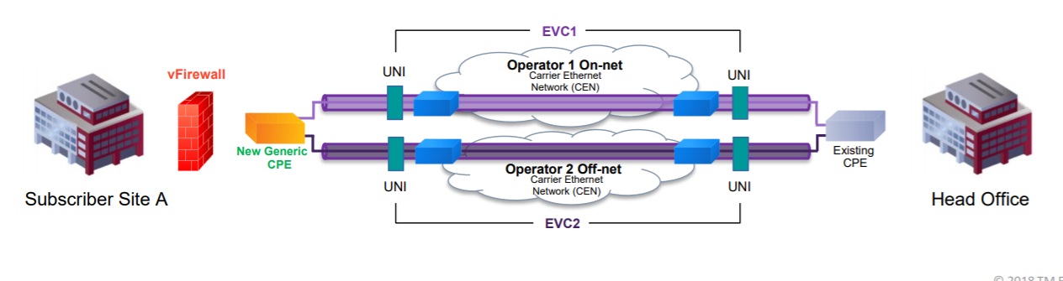
TMF NaaS Related Catalyst Projects
Automating Network as a Service. Using Operational Domain Management (ODM), TM Forum Open APIs and MEF LSO.
Champions: MEF, PCCW Global, Vodafone Group, Orange, Telstra, AT&T
Use Case: automate the lifecycle of services such as carrier Ethernet and software-defined wide area networking (SD-WAN), showing how they can be ordered through a portal and then automatically activated across hybrid networks made up of virtualized and physical components. The idea is to demonstrate orchestration of services across multiple providers and over diverse network technology domains, allowing communications service providers (CSPs) to build automated, model-driven digital ecosystems.
TMF API: TMF633 “Service Catalog ”, 640 “Service Activation and Configuration ”, 641 “Service Order Management ” , 622 “Product Ordering and Management”
Agile and automated digital enterprises
4G & 5G NaaS for B2B & B2I Business Ecosystem
NaaS in Action
5G Service Operations -Closed Loop Assurance of 5G Network Slices

Slide 9
CSPs on NaaS Journey
Telstra Embraces NaaS architecture as the core of massive network modernization effort.
Telstra NaaS platform went live in 2018
Started with internal use, now available for partners
Telstra was instrumental in creating TM Forum’s new NaaS API Component Suite
In bid to be the Telco AWS
Telus Develops New Products with NaaS
Delivering cloud-based SD-WAN
Customer can build and manage their own network thought a self-service portal
Priorities and routes traffic locally so branch offices can access cloud-based apps directly
Advanced firewall protection
Application traffic management
Backup wireless LTE connection
Vodafone uses NaaS internally first, then aims at verticals
The umbrella organization treats its 25 operating companies as customers by offering NaaS internally, and the operating
“co-creation model”, which allows the company and its customers to collaborate on developing services, in IoT, Industry robotics in Warehouse
Telefonica Business Solution Embraces NaaS for transformation
Fullstack transformation, digitizing end to end, from IT to Network
Solution is operational and offers cloud-security, IP VPN, BOD
Reported Benefits
reduce network deployment time by up to 80 per cent
reduce new product introduction time from 12-14 months to 2-4 months
greatly simplify interactions among ITs and Networks

Slide 10
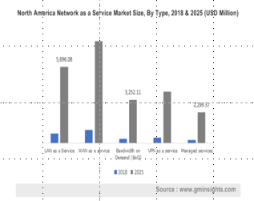
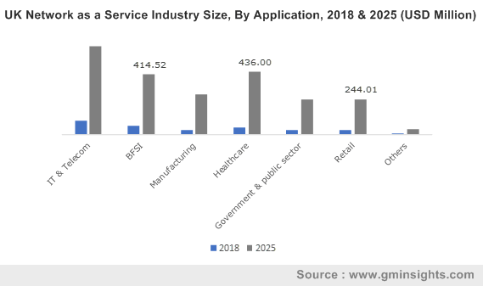
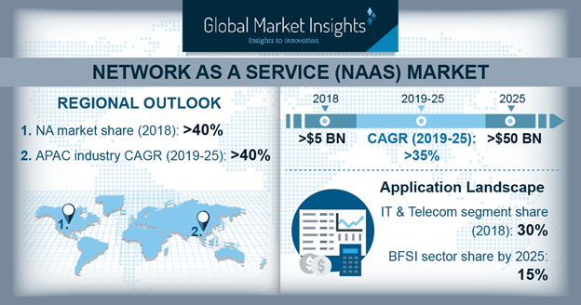
NaaS Adaption Accelerating in Global CSPs
Network as a Service (NaaS) Market size is set to exceed USD 50 billions by 2025
Drivers:
The rising demands for network virtualization technologies, SDN and NFV.
The cloudification movement.
Enterprises switching toward SDN-enabled NaaS, which help in providing on-demand network services to customers.
The rising trend of pay-per-use business model in enterprises. The NaaS model enables them to use or provide network services on a subscription-based pricing model, eliminating the need to rearchitect their networks.
SMEs use the NaaS model as it provides them with the flexibility to scale up or down the network resources .

Slide 11
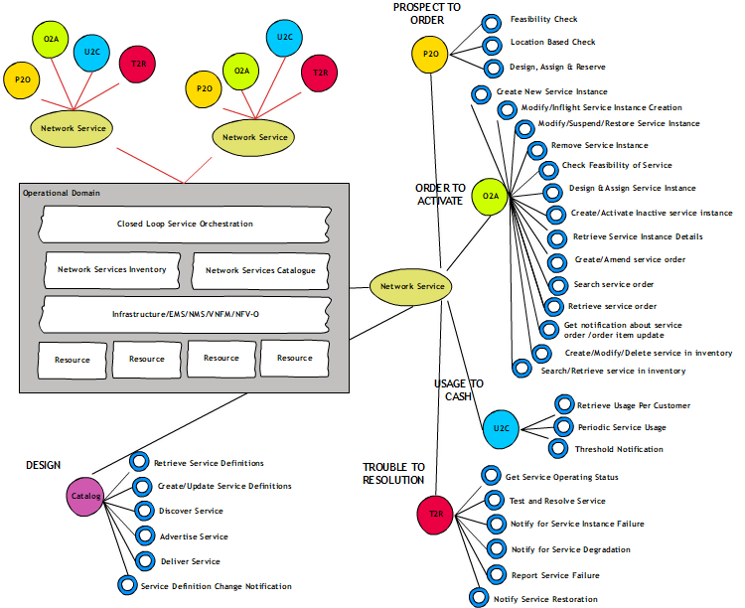
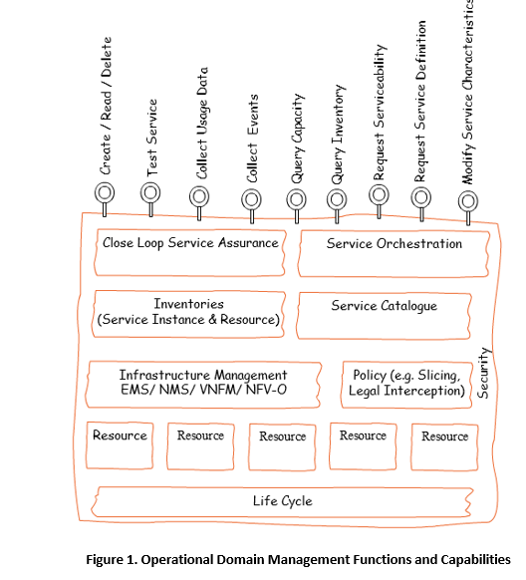
TMF 909 NaaS Management REST API Specifications
NaaS API component suite classified in the main lifecycle areas

Slide 12
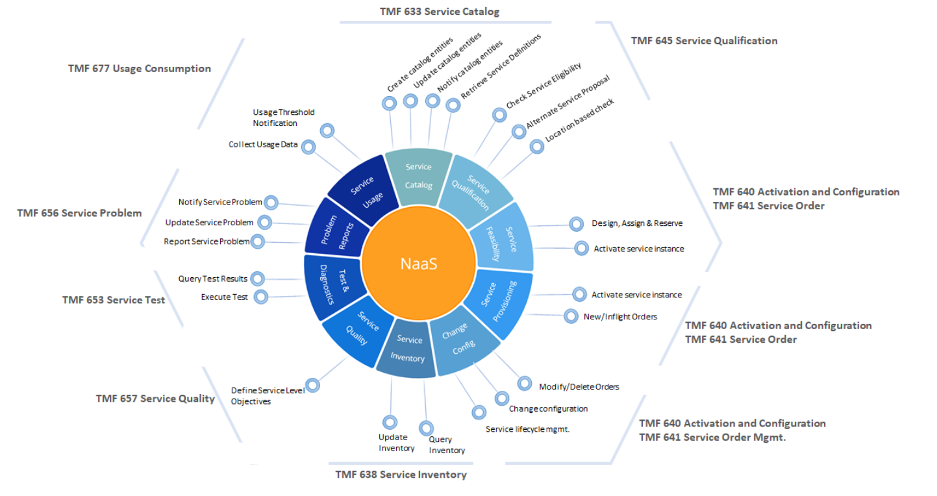
TMF 909 NaaS Components Suite APIs
Supported Business Processes:
O2A (Order to Activate),
P2O(Prospect to Order),
T2R(Trouble to Resolution),
U2C(Usage2Cash),
Service Catalog

Slide 13
TMF 909 NaaS Components Suite APIs
Service Catalog API (TMF633) – the first step is exposing the available network services, which is done through a service catalog
Service Qualification API (TMF645) – then a qualification check must be performed to determine whether a network service can be delivered
Service Ordering API (TMF641) – if qualification is successful, the network service can be ordered.
Service Activation and Configuration API (TMF640) – once it’s been qualified, the network service is reserved, activated and configured
Service Inventory API (TMF638) – when the service has been successful ordered, the service inventory is updated to show that the service is now assigned to that customer; this can be queried by the Service Inventory API.
Service Test API (TMF653) – then the network service must be tested to ensure that it’s performing properly
Service Problem API (TMF656) – if there is a problem with a network service, steps to fix it must be initiated
Usage Consumption API (TMF677) – finally usage information is collected for billing purposes
Supported Business Processes:
O2A (Order to Activate), P2O(Prospect to Order), T2R(Trouble to Resolution), U2C(Usage2Cash), Service Catalog

Slide 14
TMF OpenAPIs List
TM Forum Open APIs | Document Number
Account Management API | TMF666
Agreement Management API | TMF651
AI Management API Component Suite | TMF915
Alarm Management API | TMF642
Appointment API | TMF646
Change Management API | TMF655
Communication API | TMF681
Customer Bill Management API | TMF678
Customer Management API | TMF629
Document Management API | TMF667
Entity Catalog Management API | TMF662
Federated Identity API | TMF691
Geographic Address Management API | TMF673
Geographic Location Management API | TMF675
Geographic Site Management API | TMF674
Loyalty Management API | TMF658
Network as a Service (NaaS) API Component Suite | TMF909
Partnership Type Management API | TMF668
Party Interaction Management API | TMF683
Party Management API | TMF632
Party Role Management API | TMF669
Payment Management API | TMF676
Payment Methods API | TMF670
Performance Management API | TMF628
Performance Management Threshold API | TMF649
Prepay Balance Management API | TMF654
Process Flow Management API | TMF701
Product Catalog Management API | TMF620
Product Inventory Management API | TMF637
Product Offering Qualification API | TMF679
Product Ordering API | TMF622
Promotion API | TMF671
Quote Management API | TMF648
Recommendation API | TMF680
Resource Catalog Management API | TMF634
Resource Function Activation and Configuration API | TMF664
Resource Inventory Management API | TMF639
Resource Ordering Management API | TMF652
Resource Pool Management API | TMF685
Sales Management API | TMF699
Self Care API Component Suite | TMF910
Service Activation and Configuration API | TMF640
Service Catalog API | TMF633
Service Inventory Management API | TMF638
Service Ordering Management API | TMF641
Service Problem Management | TMF656
Service Qualification API | TMF645
Service Quality Management API | TMF657
Service Test Management API | TMF653
Shipment Tracking API | TMF684
Shopping Cart API | TMF663
SLA Management API | TMF623
Trouble Ticket API | TMF621
Usage Consumption Management API | TMF677
Usage Management API | TMF635
User Roles & Permissions API | TMF672

Slide 15
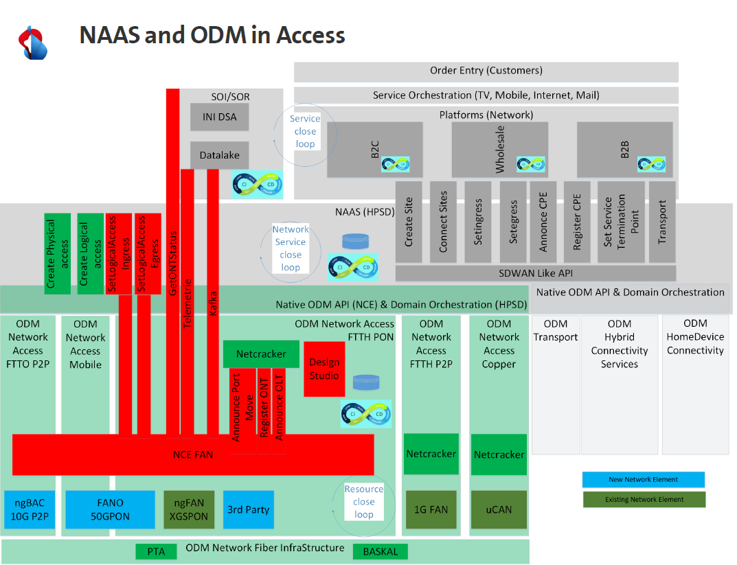
Potential TMF API Utilization in SCS NaaS Stack
Service Catalog API (TMF633)
Service Qualification API (TMF645)
Service Ordering API (TMF641)
Service Activation and Configuration API (TMF640)
Service Inventory API (TMF638)
Service Test API (TMF653)
Service Problem API (TMF656)
Usage Consumption API (TMF677)
RFS:
Service Catalog API(TMF633)
Service Actiivation and Configuration API(TMF640)
Service Inventory API(TMF638)
Resource:
Resource Catalog Management API (TMF 634)
Resource Function Activation and Config API (TMF 664)
Resource Inventory Management API (TMF 639)
Resource Ordering Management API (TMF 652)
Resource Pool Management API (TMF 685)
OR
Access: CloudCO WT-411(BBF)
Optical: ACTN(IETF)

Slide 16
Strategies for implementing NaaS
Agility,
Costs reduction
Time to market
Run
- Think about differentiated services
- Plan out how to monetize NaaS
- Embrace abstraction and open APIs
- Partner with customers and suppliers
- Re-image OSS/BSS to take advantage of flexibility, programmability and user control provided by NaaS
- Work with Network Vendors to Implement open APIs
- Internal Usage of NaaS
- Product innovation though gained agility
- Automation of NaaS
- Open NaaS to partners
- Monetize NaaS
Build
Prepare
“The hard cash benefits of NaaS are in cost avoidance based on the reuse of components, but the true benefit comes in the more positive effects of building revenue through agility”

Slide 17
Challenges of Telecom/ICT Industry
Complexity
Silo, Fragmented
Agility,
Costs reduction
Time to market
Excellent User Experience
OpEx ratio: 50%->67%,
1.9%
75B devices by 2025
TCO ＞Revenue
OpEx Vs CapEx: 3:1
Last 5 years
Infrastructure & Operations
Cost & Growth
Simplification
Automation
Intelligence
Collaboration
Efficiency
Manual, error-prone
Isolation
Lack of global business collaboration
3
vs
300+
OTT Vs Telco to maintain
The whole industry is facing the challenges of revenue growth, business collaboration, operations efficiency and TCO, which led to the reduction of profit margin, sales and innovation

Slide 18
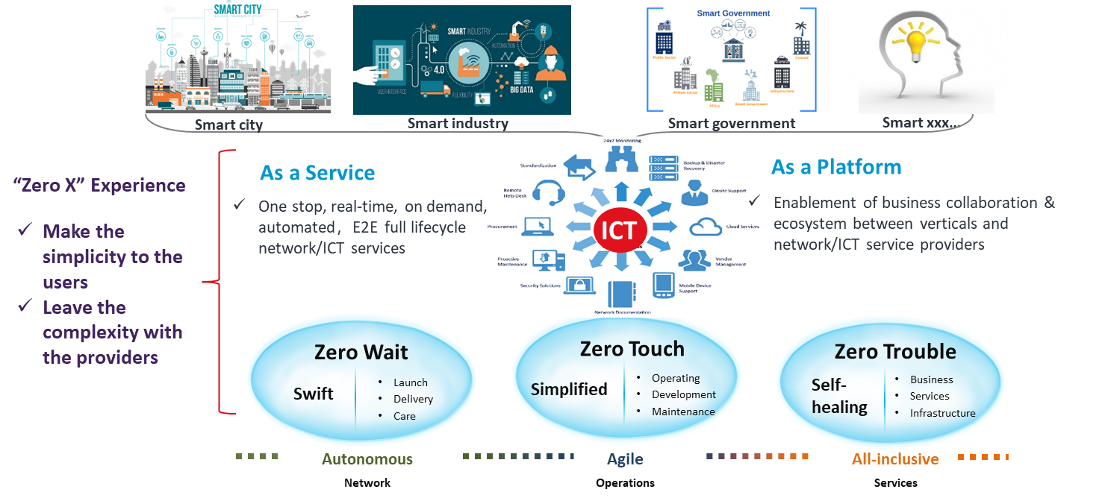
Autonomous Networks: Telecom Industry’s Grand Vision
Human’s Role Evolution
Doer
On the Loop
Examiner
Exception Handler
Out of the Loop
Designer
Trainer
Explainer
In the Loop

Slide 19
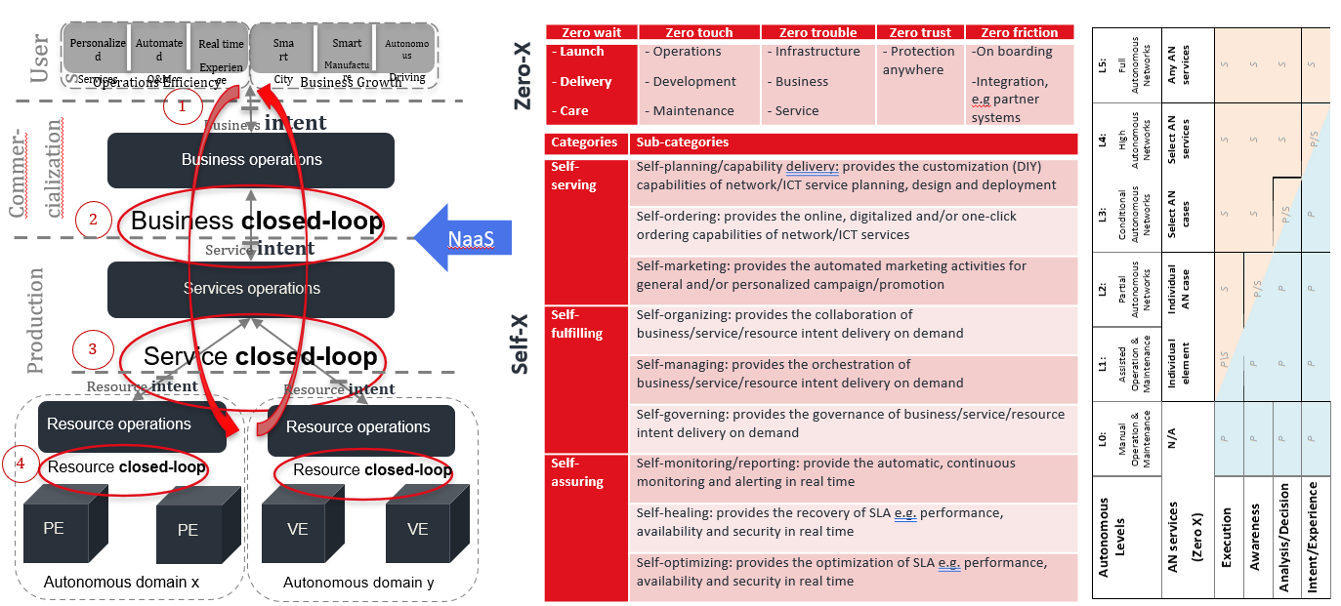
TMF AN Framework And Autonomous Levels

Slide 20












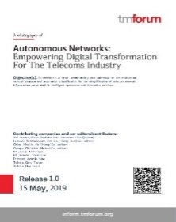
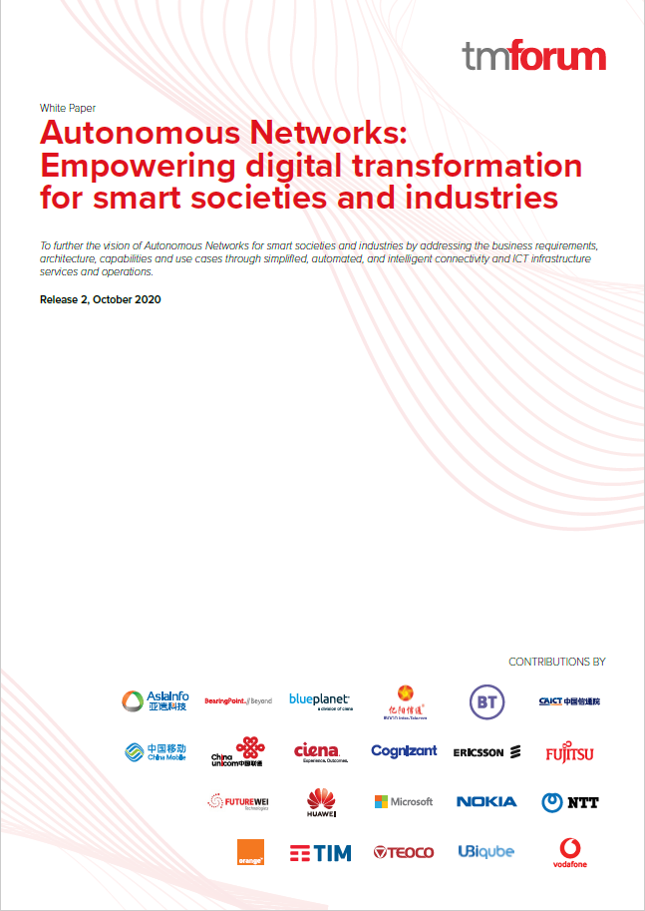
Industry ADN Consensus from Concept to SDOs Collaboration
2017.02
2019.05
2019.08
2019.8
2019.09
2019.10
2020.02
2020.05
2020.06
2020.10
ENI
work group
AN R19
white paper
MBB intelligence classification
AN architecture specifications
AI in Network
report
Network intelligence grading standards
AN Business Architecture
F5G E2E Mgmt.
& Ctrl. initiation
R17 AN grading standards Initiation
AN R20
Cross-SDOs workshop
Concept
Top-Level Architecture & Scenarios
Technical Architecture & Level Definition
Collaboration
3GPP SA5
商业自动化
Biz.
Customer, Partner and Ecosystem
CCSA TC7
ETSI F5G
Autonomous network
Working Group
Service
Network Service Operations
TMF
AN
NGMN
ETSI ENI
Resource Operation
Resource Operation
Network
GSMA
ETSI ZSM
NE
NE
VNE
VNE
R19 Whitepaper:
6 company
9 Contributors
R20 Whitepaper:
22 company
41 Contributors
Autonomous
Domain X
Autonomous
Domain Y
Cross-SDO alignment and collaboration

Slide 21
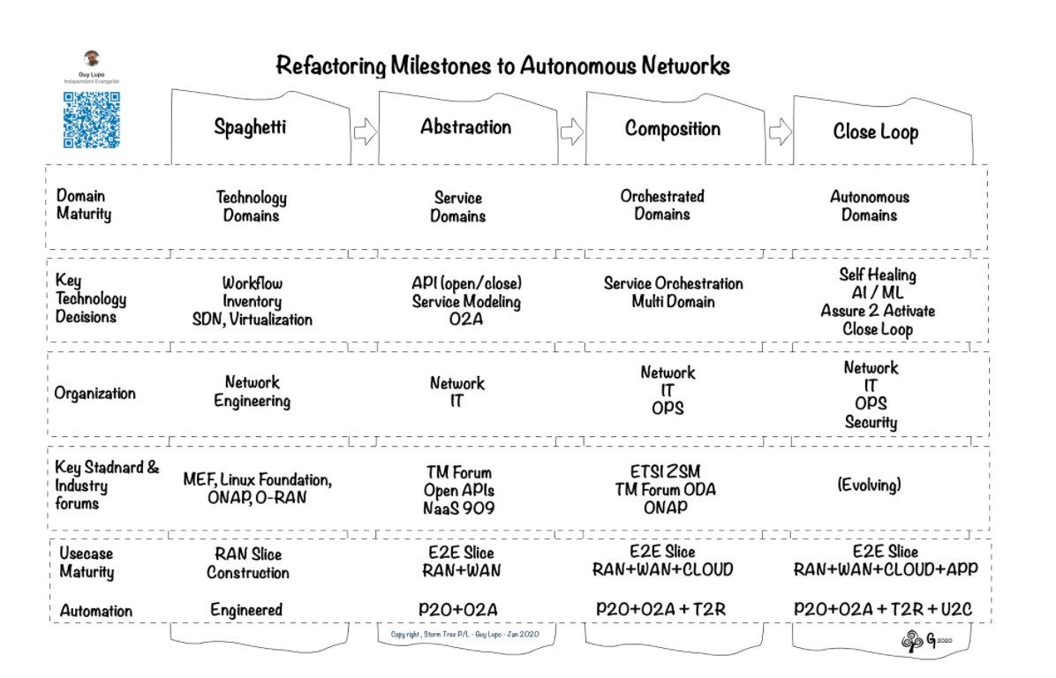
Refactoring Network to Autonomy
Infrastructure
Virtualize network devices and functions
Make network programmable
Add AI capability at device and function level
Data
Data availability should be one of the central considerations when design new network functions
Ability to instrument the data collection parameters directly on the data source
Abstraction
Configuration task is abstracted away from network management
Abstract business requirement and operational policies
Abstract the service monitoring from fixed metrics to service-oriented indications
Managing Automation
Operational staff move from managing the network devices to managing the automation process
Existing script-based, prescribed automation cannot handle unexpected situations
Operational staff will provide the boundary conditions and let network intelligence to evolve within the set boundaries.
Guy Lupo, Head of Orchestration & Data 2020, Telstra
Source: http://www.stormtree.biz/2020/02/04/network-refactoring-roadmap-matrix/

Slide 22
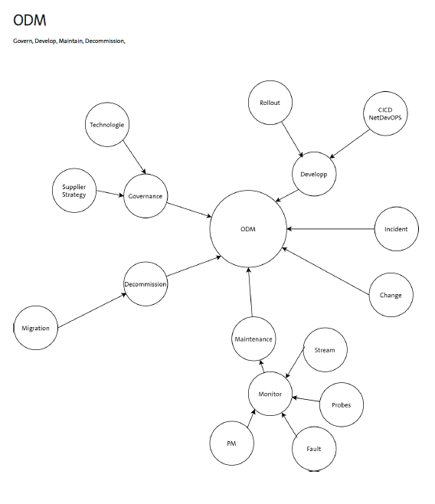

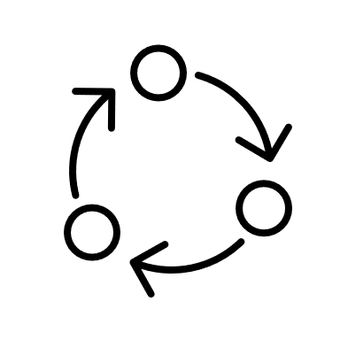

ODM to Autonomous Domain Transformation
Single Domain Autonomy, Multi Domain Orchestration
Human Managers
Autonomous Domains Orchestrators
Autonomous Domains Managers
ODMs
Managed Resources
Self-config
Self-x
Self-x
Self-verify
Autonomous Domain
Self-healing
Orchestrating within a discipline
Orchestrating cross disciplines
Self-protect
Self-config
Self-config
Self-optimize
Self-config
Self-x
Knowledge
source
NW
Compute
App
Cognitive closed loop:
Monitor, Analyze, Plan, Execute

Slide 23
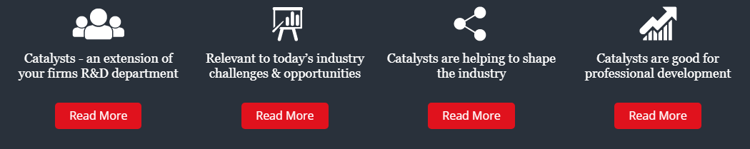
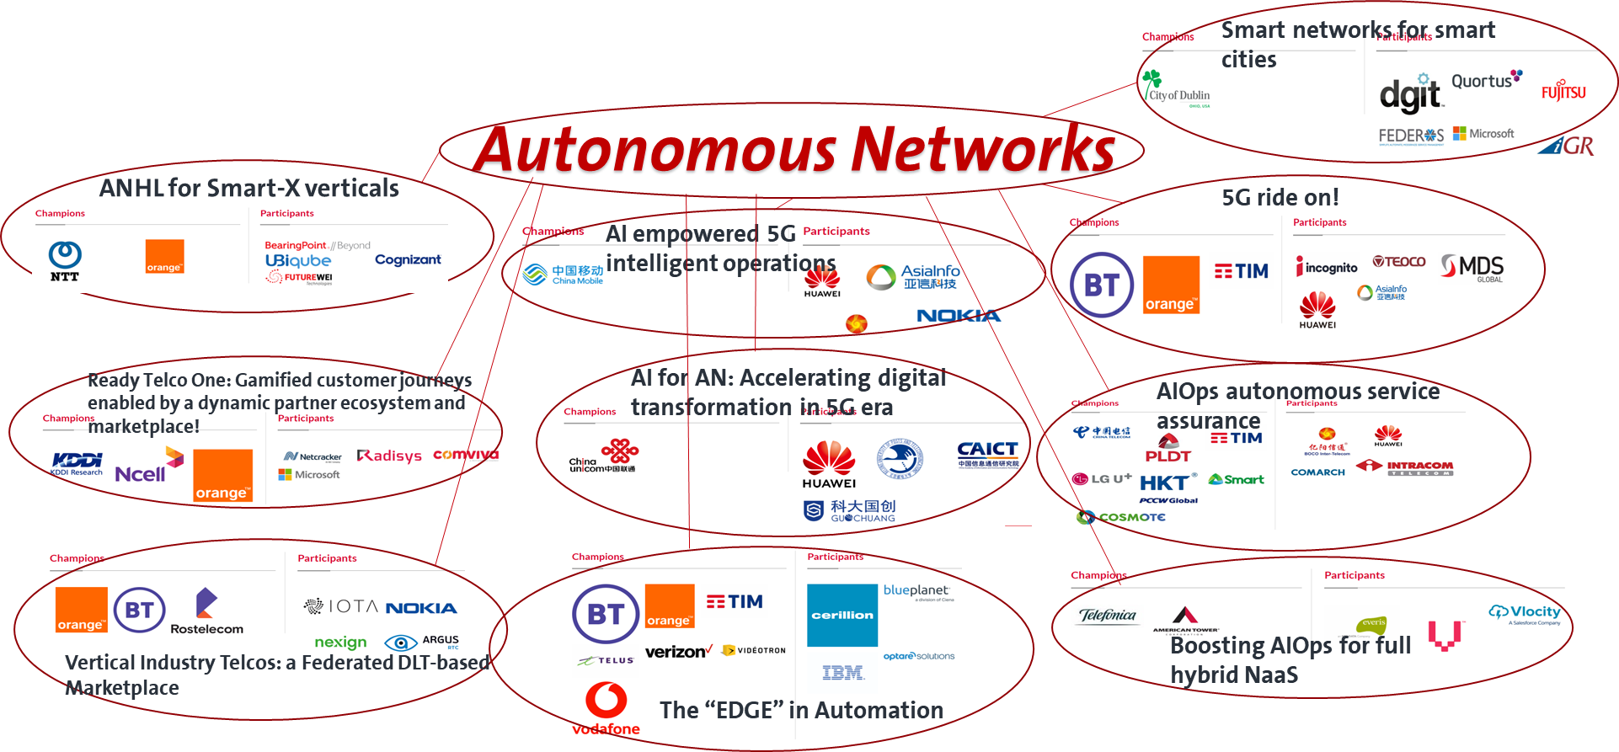
TMF AN Catalyst Projects Prototype Various Aspects of AN Concept
Benefit of Catalyst projects
Lead the industry, participate in industry voice, and improve industry influence.
Discuss topics of concern and promote industry consensus or even international standards.
Leads the exploration of cutting-edge concepts and technologies in the industry, helping you understand the technological evolution direction of networks.
Discussing digital transformation together helps us grasp the strategic development direction of enterprises and promote the success of digital transformation.

Slide 24
Autonomous Network Vision Can Only Be Realized with
Industry Collaborations
Carriers
Network Equipment Vendors
New Service Developers
Academia Researchers
BOS Suppliers
Standard Organizations
Open-Source Communities
Business Operations
High Impact Use Case Definition
Process Innovation
Requirements
Provide reference implementation
Explore and overcome technical hurdles
Accelerate product development
Develop accessible tool chains
Simplify network
Provide scenario-based APIs
Single-domain closed-loop solutions
Management, control and analytics
Define collective vision
Define terminology and taxonomy
Define reference architecture
Define interface standards
Facilitate industry collaboration
B2C, B2H, B2B,B2G applications
Develop scenario-focus use cases
Integrate AN service through Intent
Provide intelligent business platform
Integrate business, customer and partners
Support new business development
Provide E2E cross-domain, cross-vendor solutions
Fundamental research
Develop new algorithms
Develop new methodologies

Slide 25
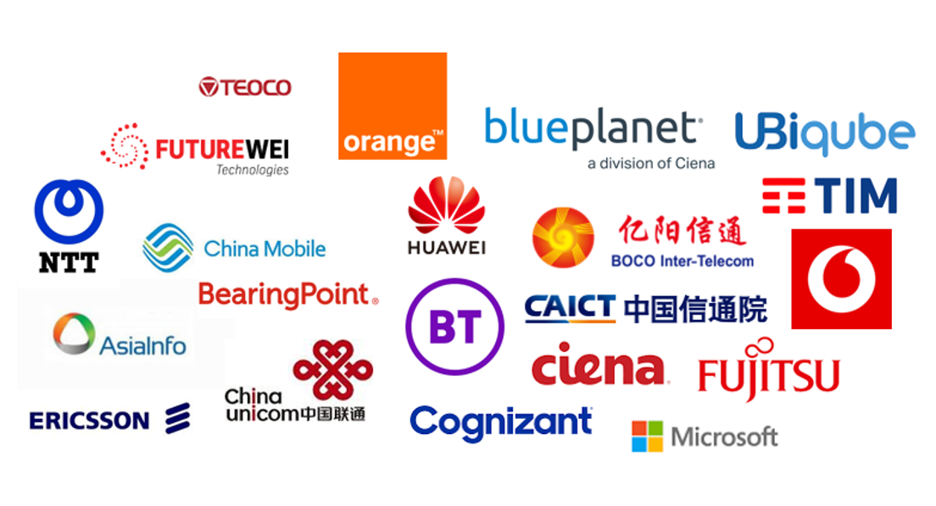

CSP’s Role in Shaping Future Autonomous Networks
1
2
3
Define a hierarchical measurement system
Define an autonomous network reference architecture
Define the critical use cases and scenarios
Unified technical and architectural languages. Technical perspective, define the medium- and long-term autonomous network reference architecture, to ensure architectural stability and advanced.
Determine use cases that bring most value The priority of closed-loop scenarios, business process innovations, new product development scenarios, human and system interaction efficiency
Determine the assessment and measurement system. Production and delivery perspective, can measure landing, guide production practice activities.

Slide 26
Discussion

Slide 27
What would be the benefit for SCS to join Industry Autonomous Networks Project?
Autonomous Networks (AN) is the most ambitious project the industry ever taken. The work in standard organization will have profound impact to CSP, OSS/BSS vendors and equipment vendors. The work is just started. By joining the TMF project, SCS can :
Ensure AN fits SCS long term digital transformation strategy,
Influence by participation,
Identify the pain points and key use cases that AN should focus on,
Share, learn, contribute and innovate with the industry.
Establish SCS as the most technology savvy CSP in Europe and long-term success.
Participate to NaaS/AN catalyst project to demonstrate NaaS/AN benefits and feasibilities.

